Slide 1
Evidence Extraction
in MRC
Dong Li
22 May 2020
Fresh business general template
Applicable to enterprise introduction, summary report, sales marketing, chart data
汇报人：优品PPT

Slide 2
01
Evidence Extraction
OUTLINE
02
Models
03
Conclusion

Slide 3
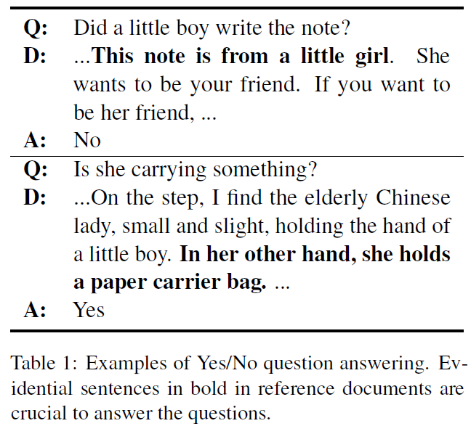
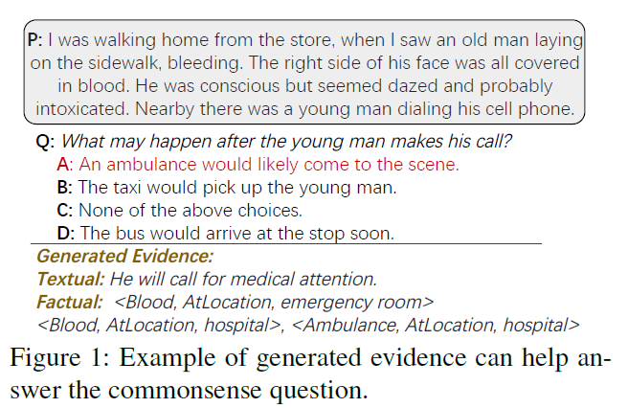
Evidence Extraction
Why to need to extract Evidence?
CosmosQA

Slide 4
Evidence Extraction
Why to need to extract evidence?
Distant supervision data inevitably accompanies with the wrong labeling problem;
Non-extractive MRC infers answers based on some evidence in reference documents, including Yes/No QA, multiple-choice MRC, ODQA;
The lack of ground truth evidence sentence labels in most cases, we should learn a good evidence extractor since there lack evidence labels for supervision;
Comprehend reasoning requires not only understanding the explicit mean but also making inferences based on implicit connection between sentences;
PTMs fail to capture sufficient knowledge and provide commonsense inference(comparison, conjunction & composition).

Slide 5
Evidence Extraction
How to model?
Evidence Extractor/Evidence Generator
1
retrieve the most relevant information from a reference text
MRC
Model
Answer Predictor
2
locate or generate answers from the extracted evidence

Slide 6
Evidence Extraction
How to extract the evidence sentences?
Weakly-surprised method
Semi-supervised method
Unsurpervised method
Reinforce learning

Slide 7
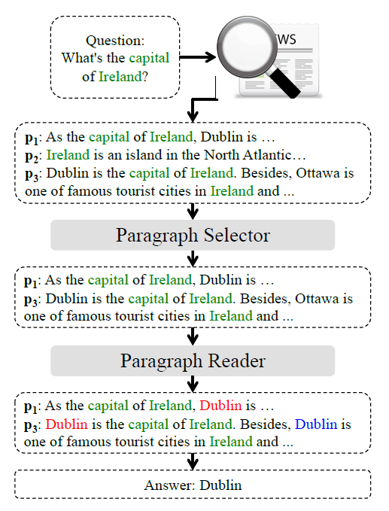
Models
Weakly-surprised method (1)
Model: a coarse-to-fine
denoising model for DS-QA
Paragraph Selector
Paragraph Reader
Denoising distantly supervised open-domain question answering (ACL 2018)

Slide 8




Models
Model
Paragraph Selector
Paragraph Encoding
Question Encoding
Denoising distantly supervised open-domain question answering (ACL 2018)

Slide 9

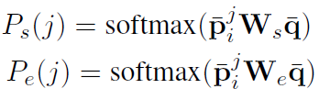


Models
Model
Paragraph Reader
a self-attention multi-layers Bi-LSTM
Denoising distantly supervised open-domain question answering (ACL 2018)

Slide 10

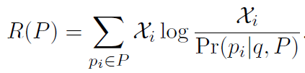


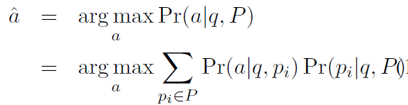
Models
Model
Learning and Prediction
: the number of paragraphs
containing correct answer in P
Denoising distantly supervised open-domain question answering (ACL 2018)

Slide 11
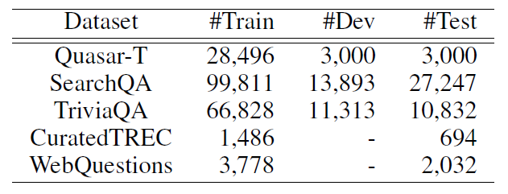
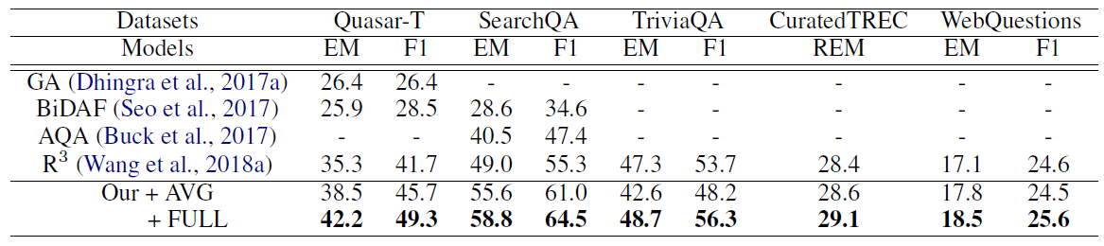
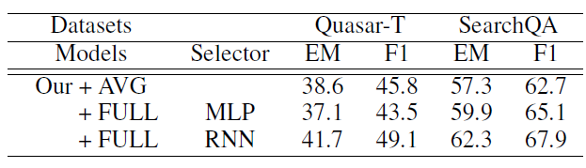
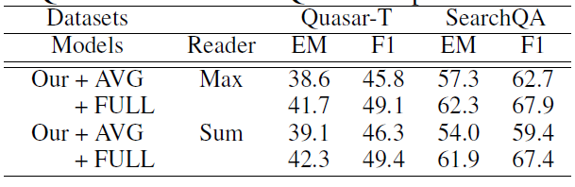
Models
Experiments
Datasets
Experiment Result
ODQA Datasets
Denoising distantly supervised open-domain question answering (ACL 2018)

Slide 12
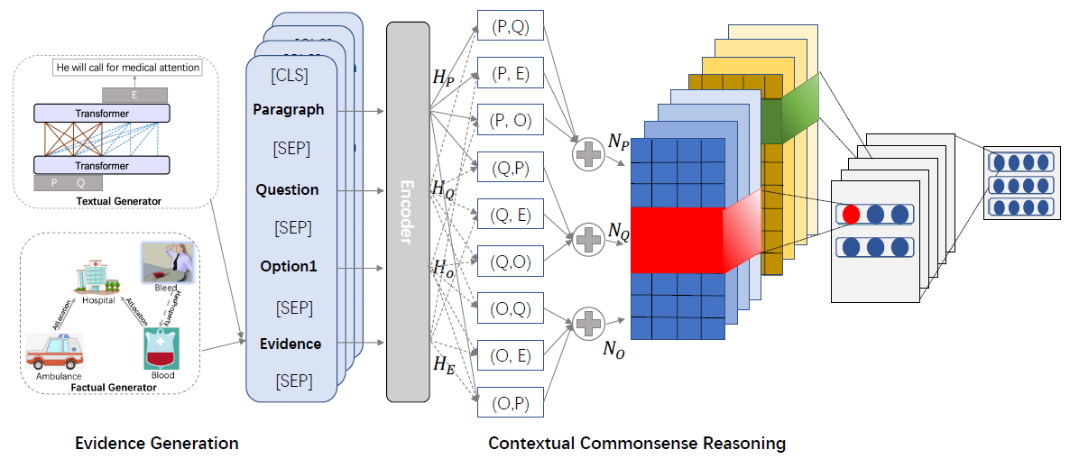
Models
Weakly-surprised method (2)
Model: Commonsense Evidence Generation and Injection Model (CEGI)
Evidence Generation
CosmosQA
Textual Evidence Generator
Factual Evidence Generator
Contextual Commonsense
Reasoning
CEGI Model
Commonsense Evidence Generation and Injection in Reading Comprehension (SIGIAL 2020)

Slide 13
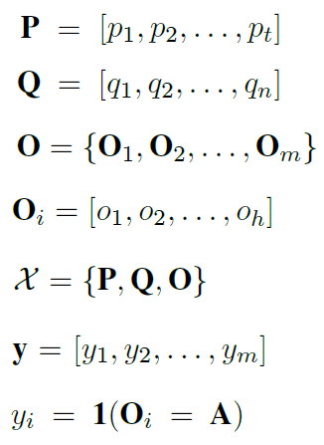


Models
Model
Task Definition
; one data sample
CEGI Model
Commonsense Evidence Generation and Injection in Reading Comprehension (SIGIAL 2020)

Slide 14
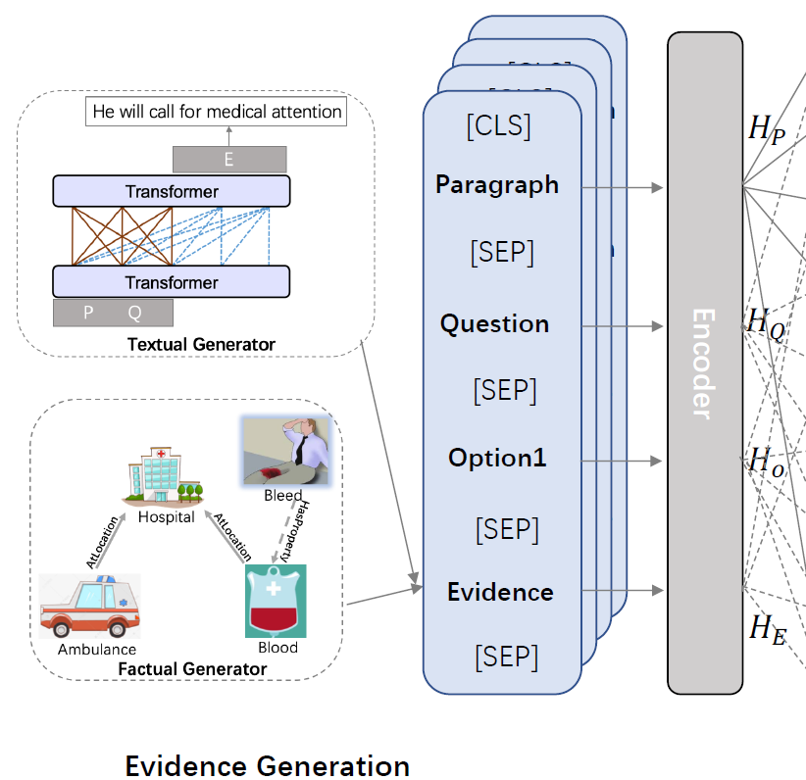


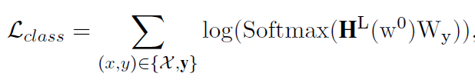

Models
Model
Evidence Generation
Textual Evidence Generator
acquire the textual evidence by PTMs (GPT2, Uniml)
Commonsense Evidence Generation and Injection in Reading Comprehension (SIGIAL 2020)

Slide 15
Models
Model
Evidence Generation
Factual Evidence Generator
utilize a factual knowledge graph to extract facts and relations
ConceptNet (base model)
knowledge graph completion algorithm (updating relation)
Commonsense Evidence Generation and Injection in Reading Comprehension (SIGIAL 2020)

Slide 16
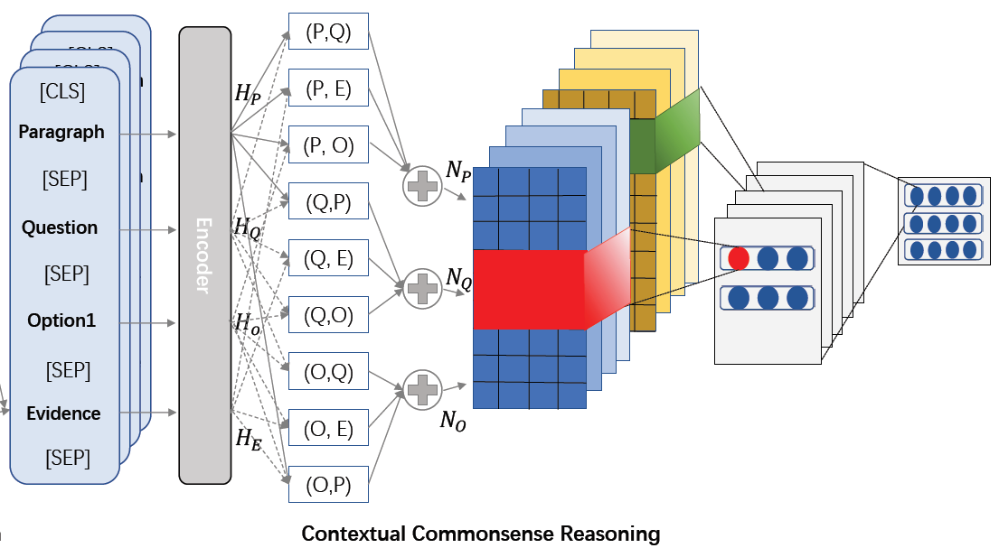
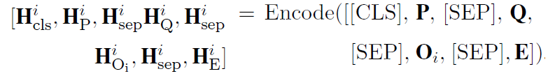
Models
Model
Contextual Commonsense Reasoning
Contextual Encoding (RoBERTa)
Commonsense Evidence Generation and Injection in Reading Comprehension (SIGIAL 2020)

Slide 17







Models
Model
Contextual Commonsense Reasoning
Evidence Injection
ATT
; bi-linear model
parameter matrix
Co-matching algorithm (token-level)
Commonsense Evidence Generation and Injection in Reading Comprehension (SIGIAL 2020)

Slide 18

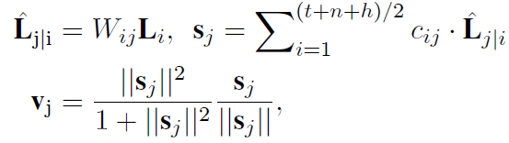
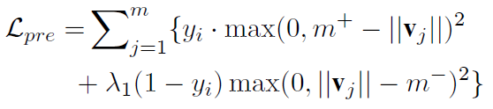
Models
Model
Contextual Commonsense Reasoning
Evidence Injection
CNN (phrase-level)
Capsule Network
Evidence Injection
Commonsense Evidence Generation and Injection in Reading Comprehension (SIGIAL 2020)

Slide 19
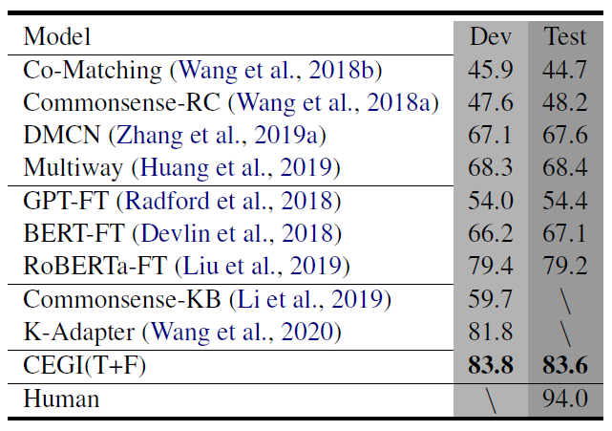
Models
Experiments
Datasets
Experiment Result
CosmosQA (Huang et al., 2019)
The dataset that is designed MRC
with commonsense reasoning
CosmosQA
Commonsense Evidence Generation and Injection in Reading Comprehension (SIGIAL 2020)

Slide 20
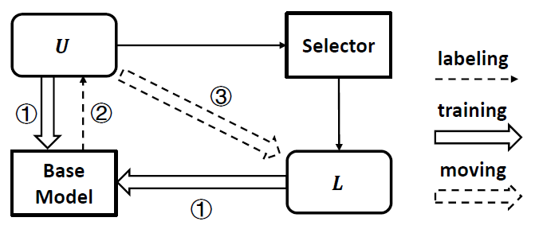

Models
Semi-surprised method
Model: Self-Training Method (STM)
Self-Training paradigm (Scudder, 1965)
Task Definition
STM Model
A Self-Training Method for Machine Reading Comprehension with Soft Evidence Extraction(ACL 2020)

Slide 21
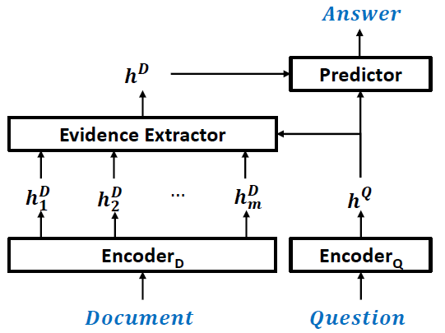
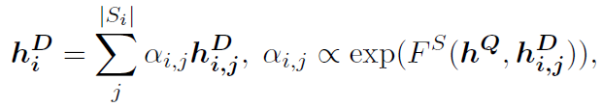
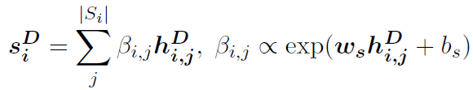
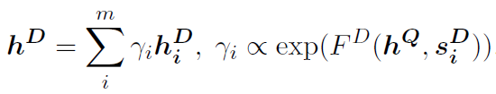
Models
Semi-surprised method
Base Model
Evidence Extractor
Token-level attention
Base Model
Sentence-level attention
A Self-Training Method for Machine Reading Comprehension with Soft Evidence Extraction(ACL 2020)

Slide 22
Models
Semi-surprised method
Base Model
Answer Predictor
YNQA : simple linear classifier
MMRC: MLP with Softmax
ODQA: 2 MLP
Base Model
A Self-Training Method for Machine Reading Comprehension with Soft Evidence Extraction(ACL 2020)

Slide 23
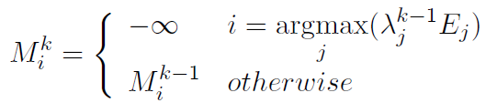

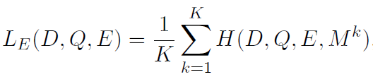
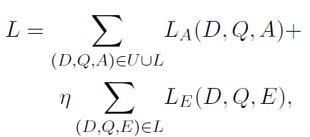
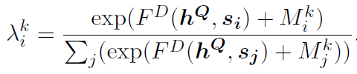

Models
Semi-surprised method
Loss Function
A Self-Training Method for Machine Reading Comprehension with Soft Evidence Extraction(ACL 2020)

Slide 24
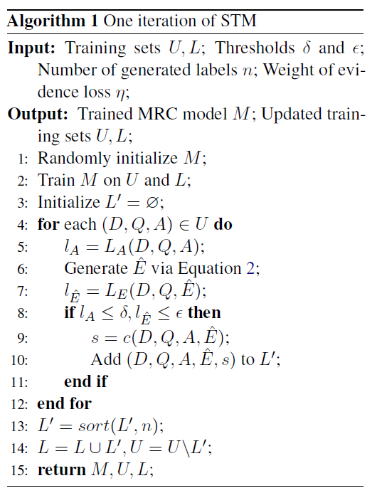

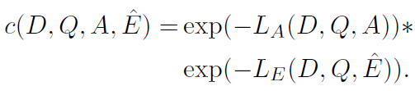
Models
Semi-surprised method
Model: Self-Training Method (STM)
each iteration consists of two stages:
Stage1: to learn a better base model for answer prediction and evidence labelling;
Stage2: to obtain more precise evidence labels for the next iteration using the updated model.
A Self-Training Method for Machine Reading Comprehension with Soft Evidence Extraction(ACL 2020)

Slide 25
Models
Experiments
Performance of answer prediction
Task
YNQA
ODQA
Base model
BERT+Hierarchical ATT
DS-QA
A Self-Training Method for Machine Reading Comprehension with Soft Evidence Extraction(ACL 2020)

Slide 26
Models
Experiments
Performance of answer prediction
Task
Base model
MMRC
BERT+Hierarchical ATT
Experiment Result
A Self-Training Method for Machine Reading Comprehension with Soft Evidence Extraction(ACL 2020)

Slide 27
Models
Experiments
Performance of evidence extraction
Task
YNQA (single evidence)
MMRC(multiple evidence)
A Self-Training Method for Machine Reading Comprehension with Soft Evidence Extraction(ACL 2020)

Slide 28
Models
Experiments
Improvement over stronger pretrained models
STM significantly improved the evidence extraction
Improvement on answer prediction is marginal
RoBERTa-HA achieved so high performance that there was limited room to improve.
Evidence information is not important for such stronger models.
A Self-Training Method for Machine Reading Comprehension with Soft Evidence Extraction(ACL 2020)

Slide 29
Conclusion
Conclusion & Future Work
Evidence extraction is still chanllenge
How to extract evidence is still chanllenge
How to extend to other NLP task is so chanllenge (such as NLI)

Slide 30
Thanks
Find yourself by creating

